Slide 2
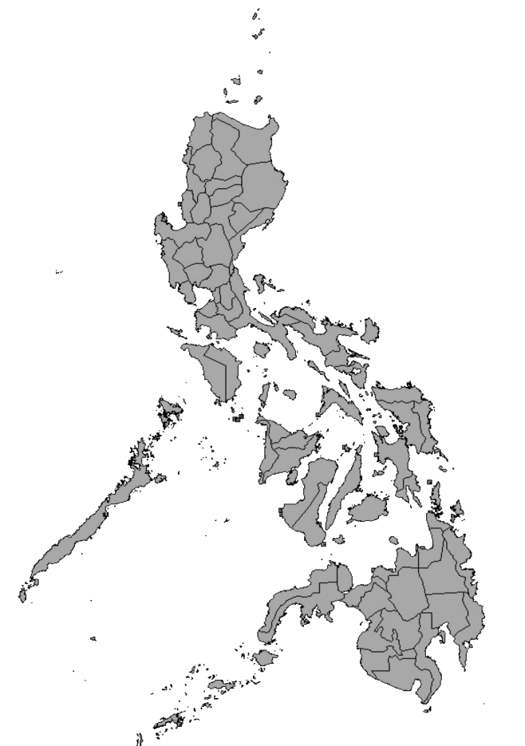
Halal Industry in a non-Muslim Country: Philippine Experience
DR. ZENAIDA (Haja Sittie Shayma) P. HR LAIDAN
Regional Director, Department/ Ministry of Science and Technology XII
Chairperson, National Halal Forum
Program Leader, Philippine Science & Technology Program for the Development of the Halal Industry
Notes:
Pictures in 3-D flip book
(Intermediate)
To reproduce the picture effects on this slide, do the following:
On the Home tab, in the Slides group, click Layout, and then click Blank.
Also on the Home tab, in the Drawing group, click Shapes, and then under Rectangles click Rectangle (first option from the left).
On the slide, drag to draw a rectangle.
Select the rectangle. Under Drawing Tools, on the Format tab, in the Size group, enter 3.71” in the Height box and 2.57” in the Width box.
Also under Drawing Tools, on the Format tab, in the Shape Styles group, click Shape Outline, and then click No Outline.
On the Home tab, in the Clipboard group, click the arrow to the right of Copy, and then click Duplicate.
Select the first rectangle. Under Drawing Tools, on the Format tab, in the Shape Styles group, click Shape Fill, and then click Picture. In the Insert Picture dialog box, select a picture and then click Insert.
Also under Drawing Tools, on the Format tab, in the Shape Styles group, click Shape Effects, point to 3-D Rotation, and then click 3-D Rotation Options. In the Format Shape dialog box, click 3-D Rotation in the left pane, and in the 3-D Rotation pane do the following:
Click the button next to Presets, and then under Perspective click Perspective Contrasting Right.
In the X box, enter 342.5°.
In the Y box, enter 57.2°.
In the Z box, enter 11°.
In the Perspective box, enter 25°.
Select the second rectangle. Under Drawing Tools, on the Format tab, in the Shape Styles group, click Shape Fill, and then click Picture. In the Insert Picture dialog box, select another picture and then click Insert.
Also under Drawing Tools, on the Format tab, in the Shape Styles group, click Shape Effects, point to 3-D Rotation, and then click 3-D Rotation Options. In the Format Shape dialog box, click 3-D Rotation in the left pane, and in the 3-D Rotation pane do the following:
In the Presets list, under Perspective, click Perspective Contrasting Right.
In the X box, enter 300.6°.
In the Y box, enter 68.7°.
In the Z box, enter 329°.
In the Perspective box, enter 0°.
Position the two rectangles so that the bottom left corners touch.
On the Home tab, in the Drawing group, click Shapes, and then under Rectangles click Rectangle.
On the slide, drag to draw a rectangle.
Select the rectangle. Under Drawing Tools, on the Format tab, in the Size group, enter 2.5” into the Height box and 3.25” into the Width box.
Also under Drawing Tools, on the Format tab, in the Shape Styles group, click Shape Outline, and then click No Outline.
On the Home tab, in the Clipboard group, click the arrow to the right of Copy, and then click Duplicate.
Select the third rectangle. Under Drawing Tools, on the Format tab, in the Shape Styles group, click Shape Fill, and then click Picture. In the Insert Picture dialog box, select a picture and then click Insert.
Also under Drawing Tools, on the Format tab, in the Shape Styles group, click Shape Effects, point to 3-D Rotation, and then click 3-D Rotation Options. In the Format Picture dialog box, click 3-D Rotation in the left pane, and in the 3-D Rotation pane do the following:
Click the button next to Presets, and then under Perspective click Perspective Contrasting Right.
In the X box, enter 303.1°.
In the Y box, enter 313°.
In the Z box, enter 78°.
In the Perspective box, enter 100°.
Select the fourth rectangle. Under Drawing Tools, on the Format tab, in the Shape Styles group, click Shape Fill, and then click Picture. In the Insert Picture dialog box, select a picture and then click Insert.
Also under Drawing Tools, on the Format tab, in the Shape Styles group, click Shape Effects, point to 3-D Rotation, and then click 3-D Rotation Options. In the Format Picture dialog box, click 3-D Rotation in the left pane, and in the 3-D Rotation pane do the following:
Click the button next to Presets, and then under Perspective click Perspective Contrasting Right.
In the X box, enter 310.3°.
In the Y box, enter 330°.
In the Z box, enter 63°.
In the Perspective box, enter 90°.
Also in the Format Picture dialog box, click Shadow in the left pane, and in the Shadow pane, do the following:
Click the button next to Color, and then under Theme Colors click Black, Text 1.
In the Transparency box, enter 47%.
In the Size box, enter 102%.
In the Blur box, enter 16 pt.
In the Angle box, enter 160°.
In the Distance box, enter 4 pt.
Position the third and fourth rectangles so that the left corners touch the bottom left corners of the first and second rectangles.
To reproduce the background effects on this slide, do the following:
Right-click the slide background area, and then click Format Background. In the Format Background dialog box, click Fill in the left pane, select Gradient fill in the Fill pane, and then do the following:
In the Type list, select Linear.
Click the button next to Direction, and then click Linear Down (first row, second option from the left).
Under Gradient stops, click Add gradient stops or Remove gradient stops until four stops appear in the slider.
Also under Gradient stops, customize the gradient stops as follows:
Select the first stop in the slider, and then do the following:
In the Position box, enter 0%.
Click the button next to Color, and then under Theme Colors click White, Background 1, Darker 15% (third row, first option from the left).
Select the next stop in the slider, and then do the following:
In the Stop position box, enter 56%.
Click the button next to Color, and then under Theme Colors click White, Background 1, Darker 5% (second row, first option from the left).
Select the next stop in the slider, and then do the following:
In the Stop position box, enter 57%.
Click the button next to Color, click More Colors, and then in the Colors dialog box, on the Custom tab, enter values for Red: 169, Green: 169, Blue: 169.
Select the last stop in the slider, and then do the following:
In the Stop position box, enter 100%.
Click the button next to Color, click More Colors, and then in the Colors dialog box, on the Custom tab, enter values for Red: 211, Green: 211, Blue: 211.

Slide 3
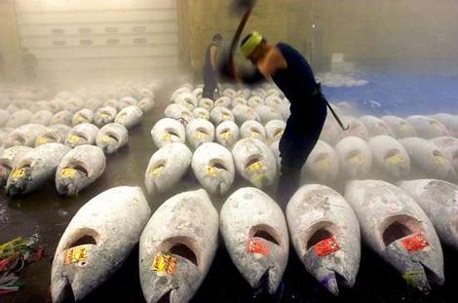
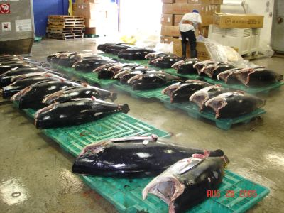
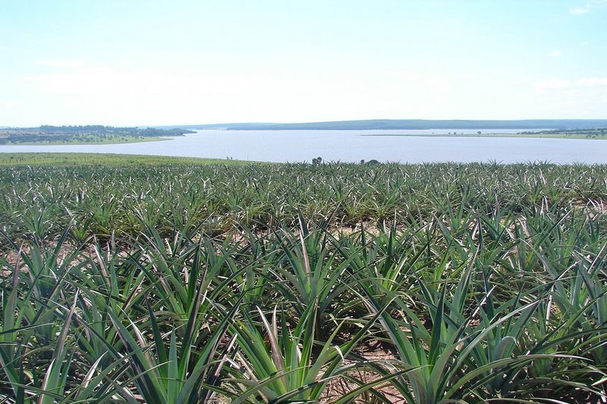
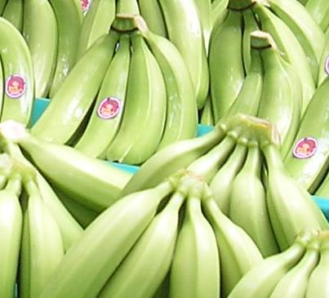
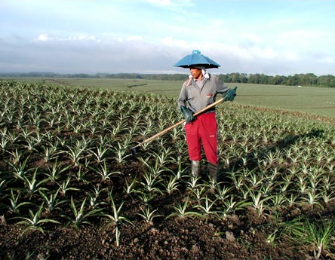
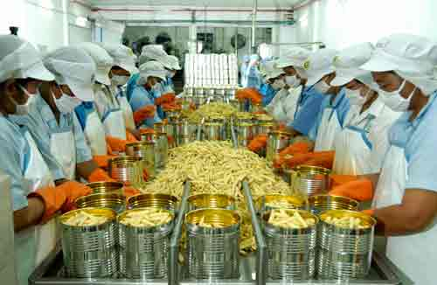
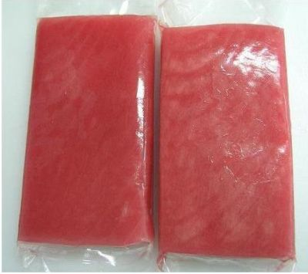
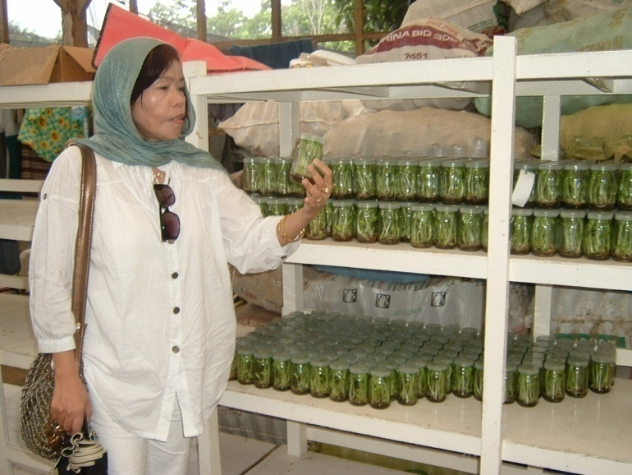
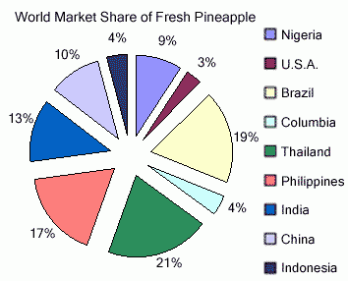
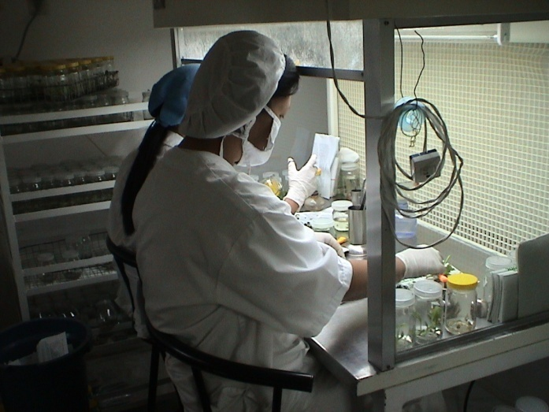
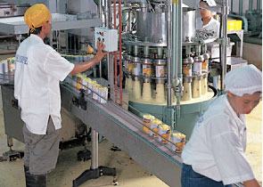
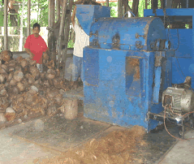

Slide 4
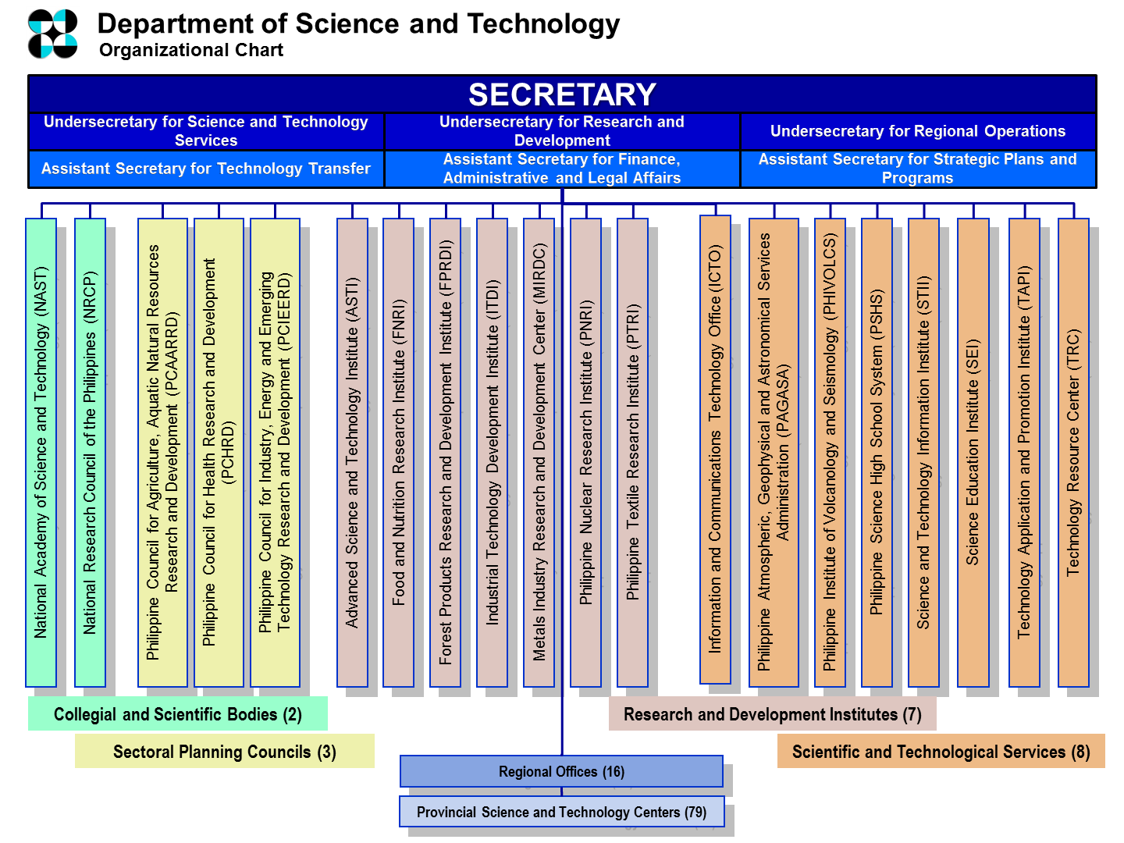

Slide 5
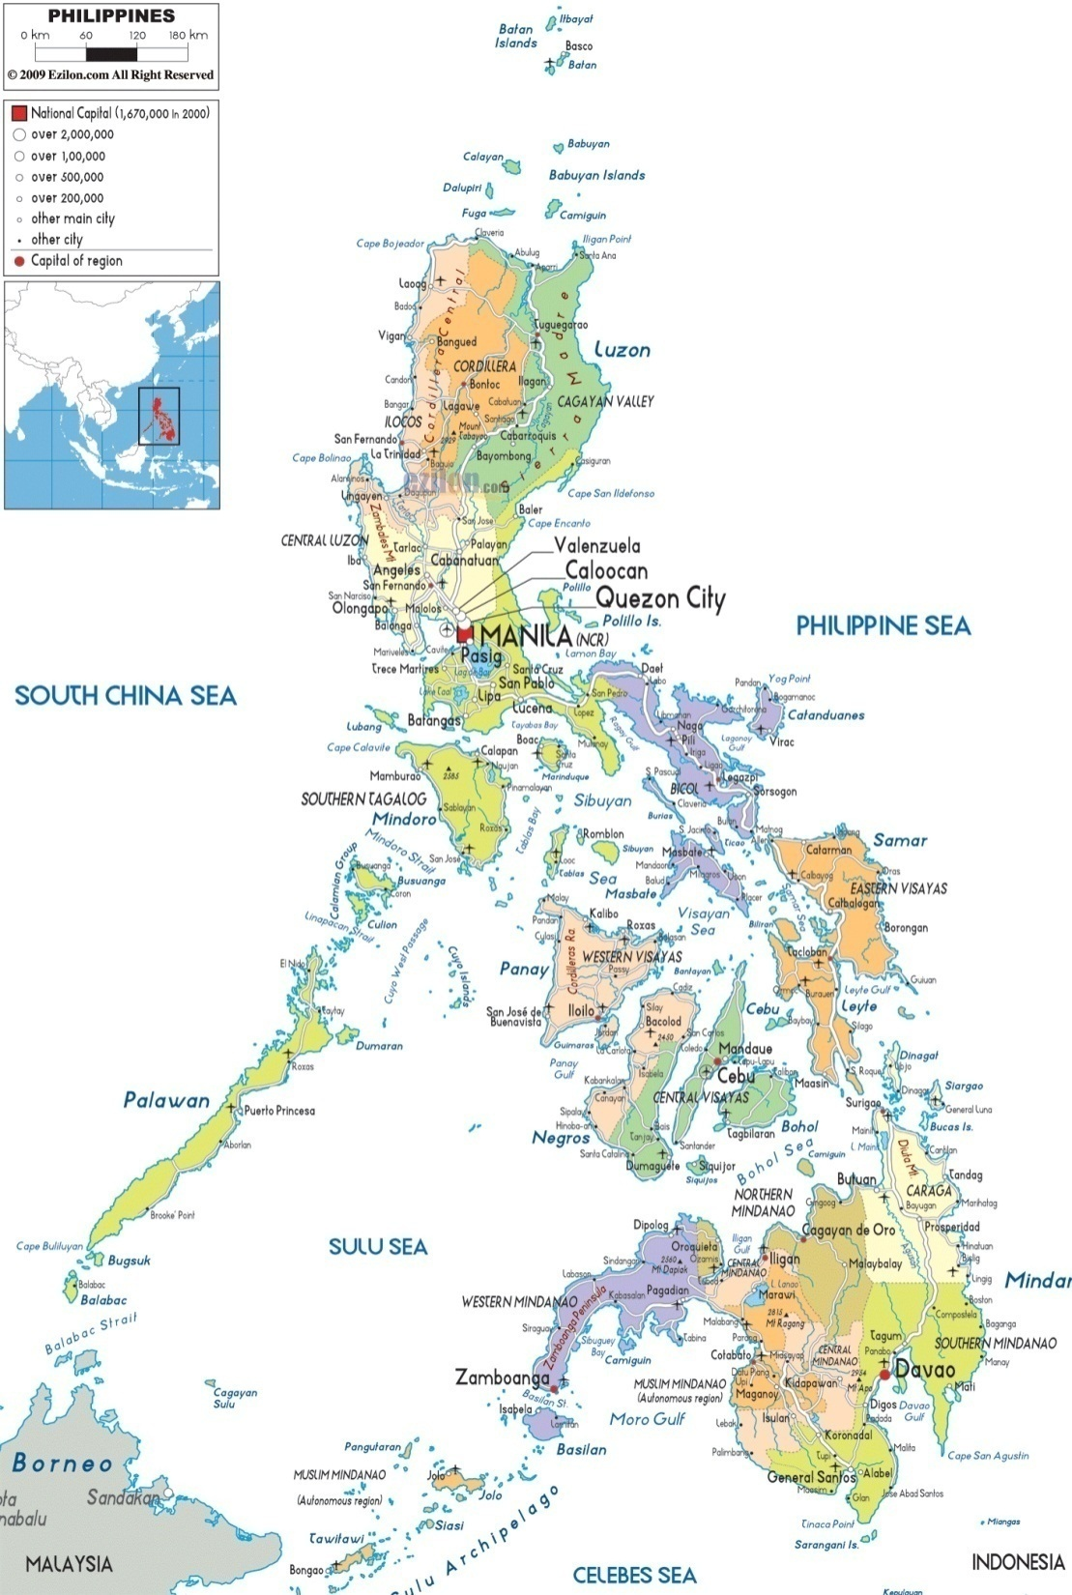
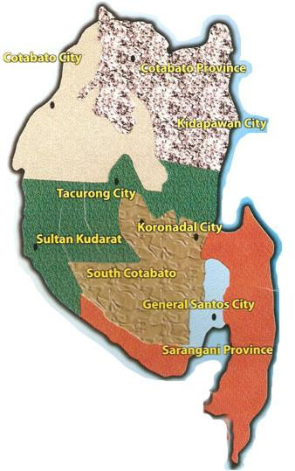
Luzon
REGION XII
Visayas
Mindanao

Slide 6
DOST XII

Slide 7
DOST MANDATES
Provide central direction, leadership and coordination of all scientific and technological efforts in the country.
Formulate S&T policies, programs, and projects in support of national development priorities.

Slide 8
Issues concerning Halal in the Philippines
There is no Halal hotel or restaurant yet in the Philippines accredited by competent authority of the country in terms of the religious and technical aspects of Halal;
Existing certification and accrediting bodies which are from the private sector do not have the capability;

Slide 9
Issues concerning Halal in the Philippines
Products claimed Halal were once rejected and returned back to the Philippines after verification thru the laboratory;

Slide 10
Issues concerning Halal in the Philippines
Companies are being accredited without complying with the requirements;
The government now is at the helm in developing the Halal Industry.

Slide 11
PHILIPPINE SCIENCE AND TECHNOLOGY PROGRAM FOR THE DEVELOPMENT OF THE HALAL INDUSTRY

Slide 12
Goals and Objectives
aims to support the Five-Point Agenda of the President of the Republic of the Philippines, His Excellency Benigno Simeon Aquino III:
Anticorruption and good governance;
Poverty reduction and empowerment of the poor;
Sustained economic growth;
Just and lasting peace;
Rule of law and integrity of the environment.
in consonance with the priority High Impact Technology Solutions of DOST Minister/ Secretary, Honorable Mario G. Montejo:
R&D for priority sectors
Technology transfer and diffusion
Area-based programs with impact on regions and provinces
Innovation Promotion/Advocacy and Policy Development
Facilities Upgrading
Innovative HRD Programs
Assistance to Inventors

Slide 13
Components
Advocacy and Policy Development
Capacity-building and Human Resource Development
Halal ICT: Information Management System
Support to Halal SMEs
Establishment of the Philippine National Halal Laboratory and Halal Science Center
Halal Certification and Accreditation

Slide 14
1st Component:
Advocacy and Policy Development

Slide 15
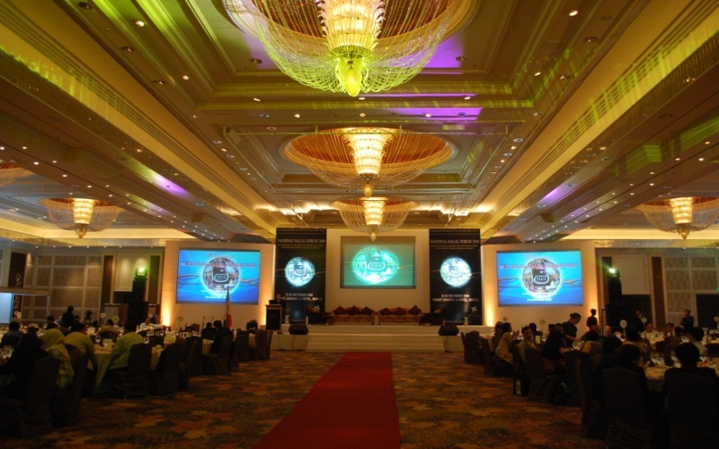
Advocacy and Policy Development
Philippine National Halal Forum held in Manila at the Makati Shangri-La Hotel

Slide 16
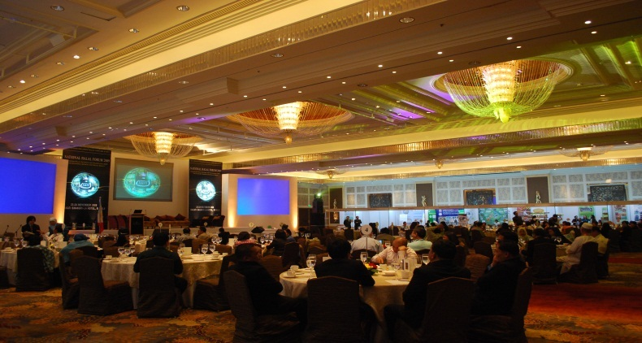
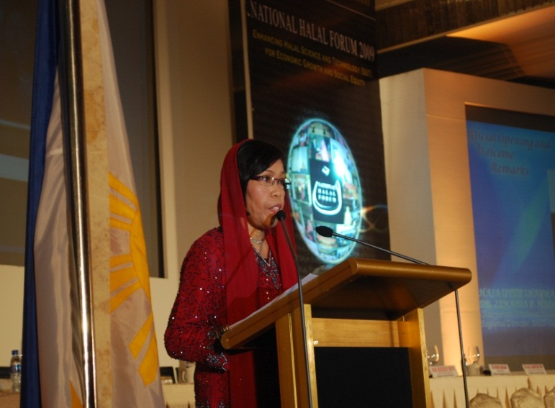
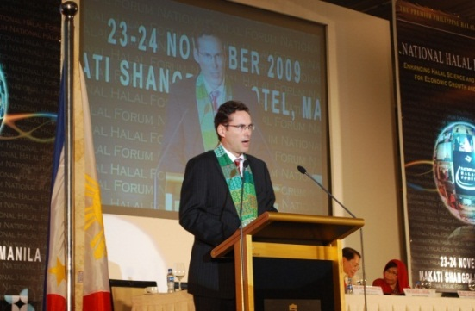
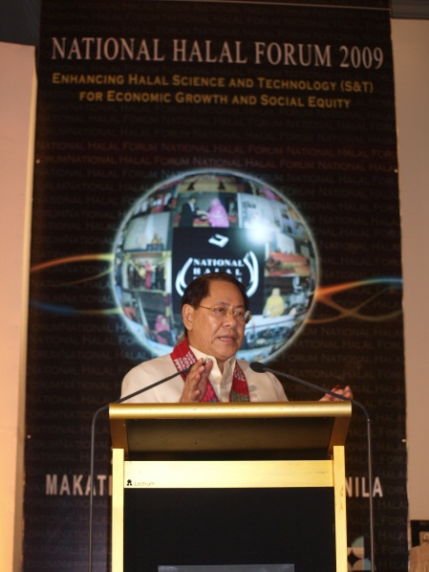
Advocacy and Policy Development
Philippine National Halal Forum held in Manila at the Makati Shangri-La Hotel

Slide 17
2nd Component: Capacity Building and Human Resource Development

Slide 18
Development of Human Resource needed to man/ complement the Philippine Halal Industry;
Roll-out of Trainers training for Halal Auditors;
Trainings on Halal cGMP, Halal HACCP, Halal packaging and labeling, etc.
Assessment of the preparedness of firms to engage in Halal business;
Halal techno-based entrepreneurial training;
Integration of Halal Science in the curriculum.

Slide 19
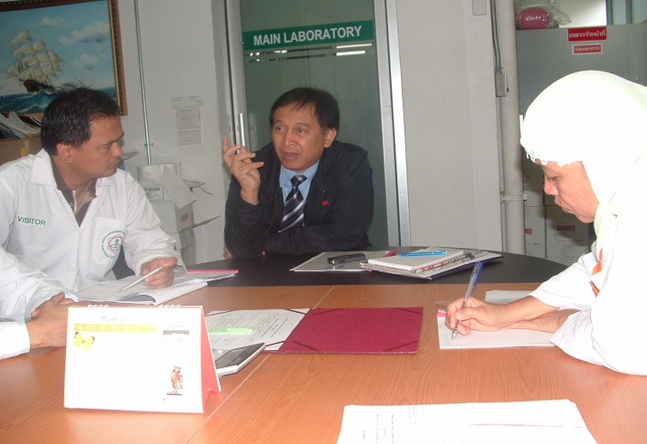
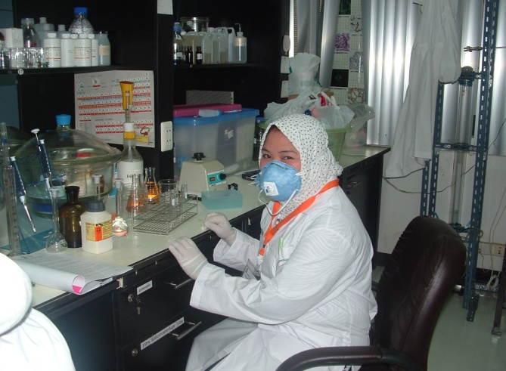
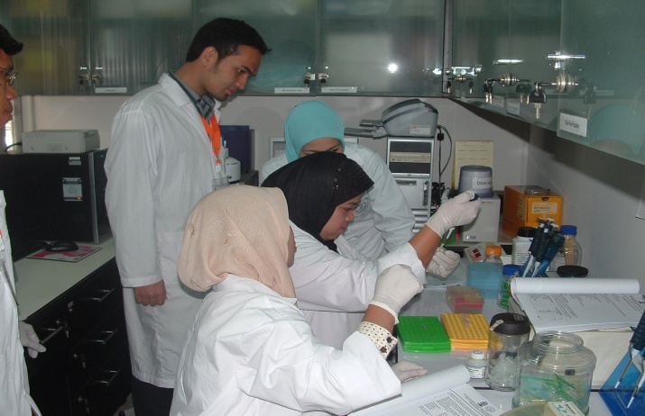
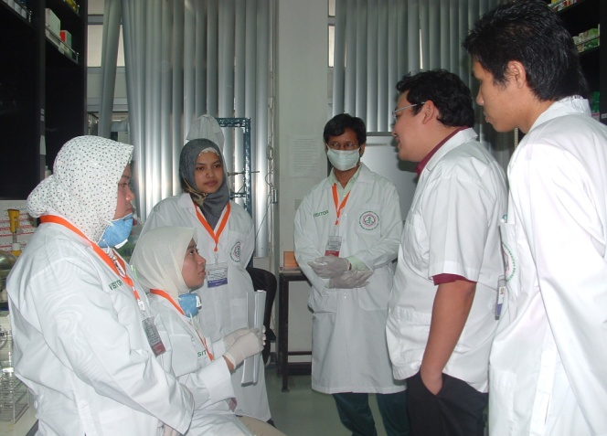
Capacity-building and Human Resource Development

Slide 20
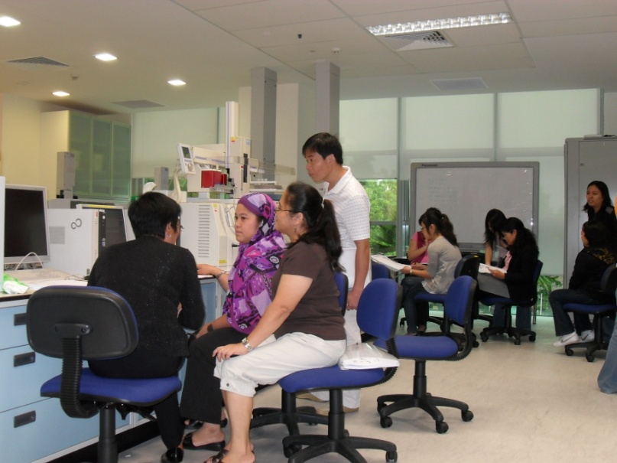
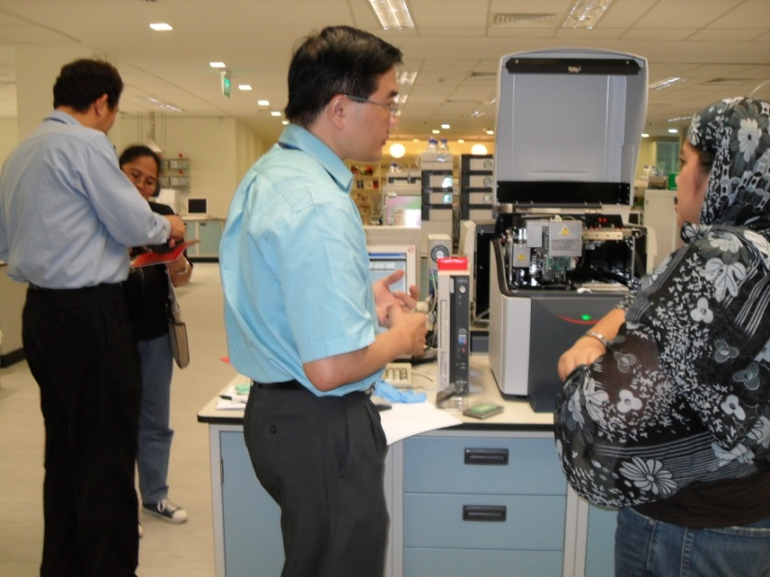
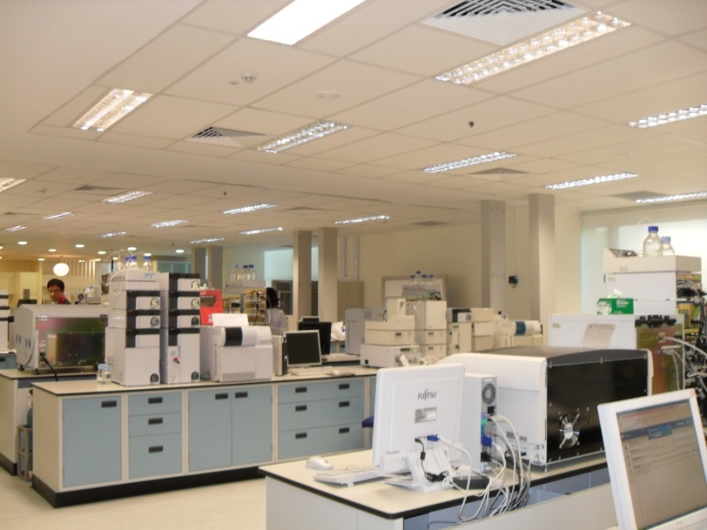
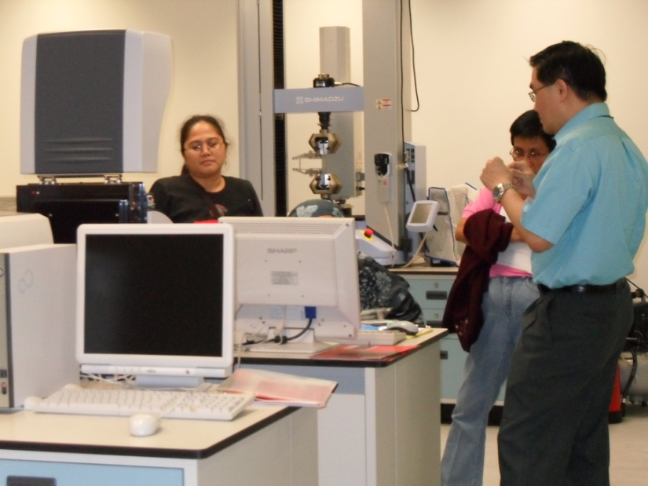
Capacity-building and Human Resource Development

Slide 21
3rd Component:
Halal ICT: Halal Information and Management System

Slide 22
Access to World Wide Web
Halal Certification Bodies ( Competent Authority)
Halal Science Information System
Halal Traceability and Halal Tracking Systems
Upgrading of the National Halal Information Management System
Halal Information System

Slide 23
Status as of January 2012
Information Management System for Halal
Upgrading of the Philippine Halal Information Management System is on-going that includes Traceability and Surveillance System for Halal;
Acquired some of the needed IT equipment for the Halal Information Management System.

Slide 24
4th Component:
Support to Halal SMEs

Slide 25
S&T Support to Halal SMEs
Small
Enterprise
Technology
Upgrading
Program is a nationwide strategy
To encourage and assist MSMEs in adopting technological innovations
To enhance operational efficiency, and
Boost productivity and competitiveness.

Slide 26
SET-UP Goal
Superior Product
Quality
Human Resources
Development
Cost Minimization
Waste Management
It aims to empower firms to address technical problems through technology transfer and technological interventions.
MSMEs
Technology-based solutions to improve productivity

Slide 27
DOST interventions thru SETUP
Provision of Technology
Packaging and labeling
Product Standards and Testing
Database Management and Information System
Linkaging and Networking

Slide 28
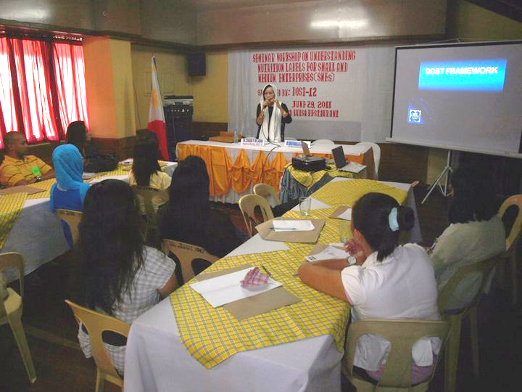
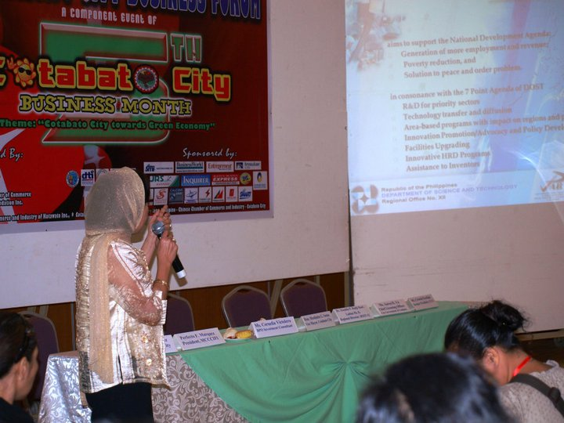
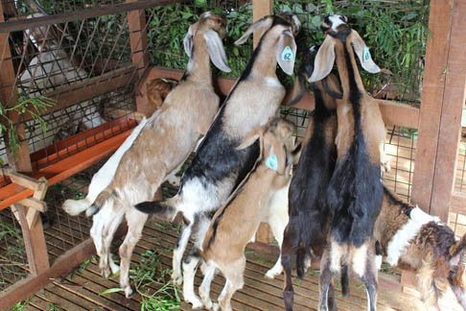
Provision of Halal technology
Conduct Halal technology needs assessment and sourcing of technology;
Provide Halal ISSF for technology fabrication/ acquisition;
Provide manpower training for Halal Quality Assurance (GMP, HACCP, Packaging and Labeling, forensic lab, audit/ surveillance and traceability);
Provide consultancy and technical services;
Conduct Halal R&D for product development and process improvement

Slide 29
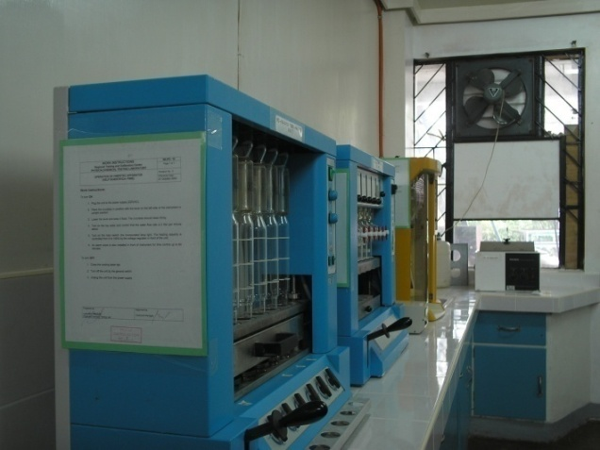
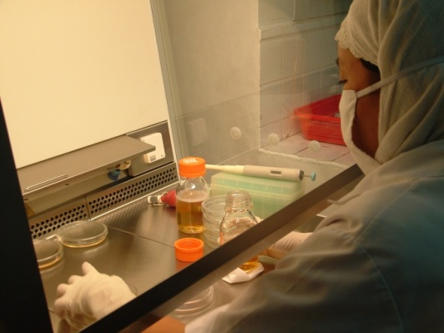
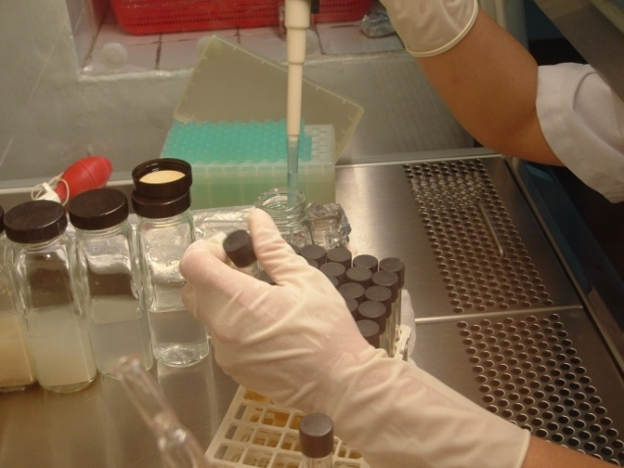
Product Standards and Testing
Establishing product standards for Philippine products to help enterprises compete locally and globally.
Product testing and enhancement of testing laboratories to provide wider range of testing services and improve testing efficiency and consistency of results.

Slide 30
Packaging and Labeling
To assist MSMEs for suitable packaging of products to increase shelf life, improve handling and protection and ultimately improve marketability.
Functional designs for packages
Identifying and developing alternative packaging materials from indigenous materials.

Slide 31
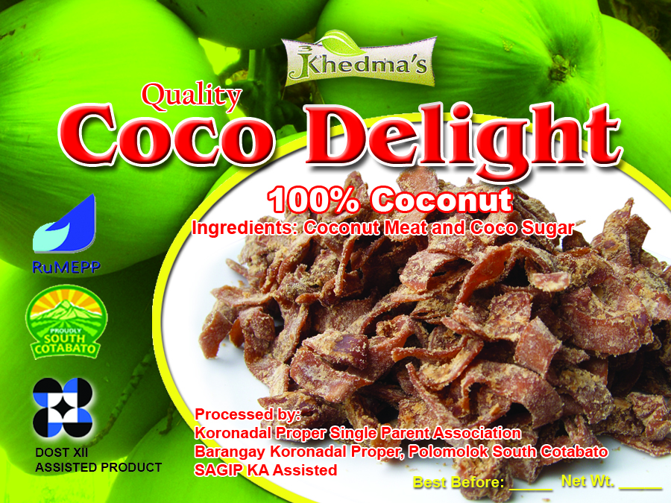

Slide 32
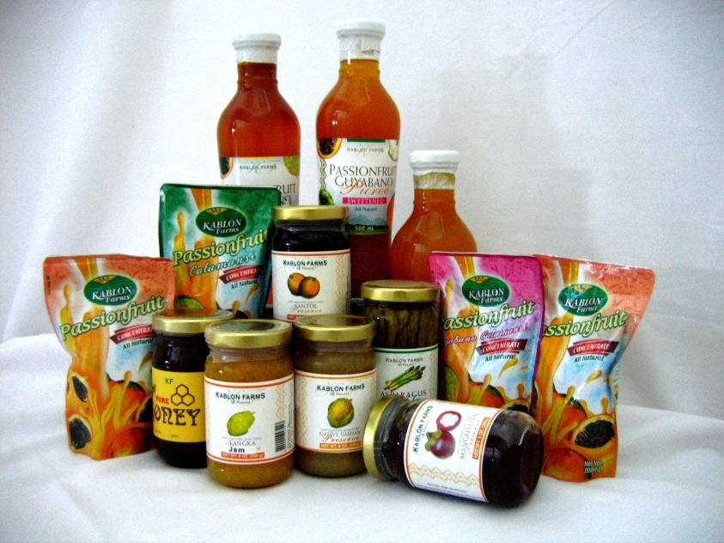
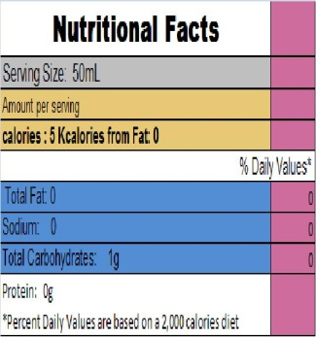
PACKAGING TECHNOLOGY ASSISTANCE PROGRAM
Interventions:
Provision of technical assistance, consultancy services, research and development and laboratory tests and analysis
DOST XII offered the following services:
Label design
Package-Product compatibility testing
Nutritional analysis
Packaging development
Consultancy services
Training on basic packaging and labeling requirements

Slide 33
Database Management and Information System
Listing of available technologies at the regional and national level
Listing of S&T experts
Listing of technology laboratories including services provided and costs.
Hosting online databases; accessible thru the DOST Websites
TACIS Info System
S&T experts Database

Slide 34
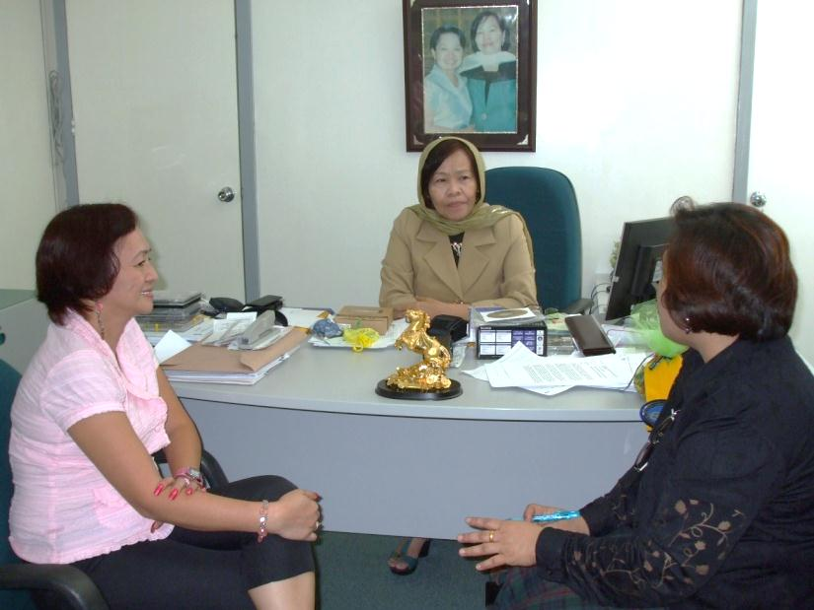
Linkaging and Networking
Raw material sourcing and researches are done to determine its material characteristics and processing properties.
Backward linkages with suppliers and government and non-government agencies are being established.

Slide 35
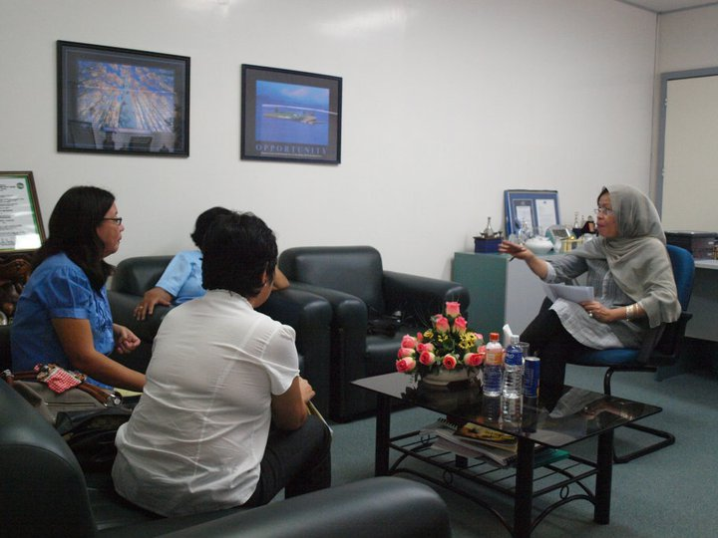
Linkaging and Networking
Technical/entrepreneurial training in partnership with relevant institutions to provide the training needs of firms;
Linkages with financing institutions for technology acquisition, production expansion and marketing;
Equipment Design and fabrication of equipment

Slide 36
Status as of January 2012
DOST XII Assistance to SMEs
-Identified and assisted potential beneficiaries/ partners within the Halal Value-Chain particularly in livestock, horticulture, marine and aquaculture and Halal ICT as priority sectors;
-Identified number of farms conformant to Halal Requirements;

Slide 37
Status as of January 2012
DOST XII Assistance to SMEs
- Released funding for the establishment of Halal Feedmill;
Initiated the establishment of Halal Meat Production Center, Halal Dairy Farm and Halal Cheese Production (e.g. Goats, chickens, etc.)
Conducted meetings with key partners in the government, academe, industry/ private sector for the clustering of the Halal Industry and in pursuing Halal projects including health R&D for the development of Halal cosmetics and Halal pharmaceuticals.

Slide 38
5th Component: Establishment of the Philippine National Halal Laboratory and Halal Science Center (PNHLSC)

Slide 39
PNHLSC Objectives
In consonance with the religious aspect, it aims to address the scientific requirements to ensure Halal integrity in food and non-food products.
The laboratory tests and certifies/ authenticates halalness of the product to ascertain that all the ingredients used by manufacturers are halal, as stipulated in Islam.
Provide micro, small and medium-scale enterprises access to laboratory facilities to comply with Halal market requirements.

Slide 40
Laboratory Features and Services
an integrated one-stop-shop Halal S&T Incubation Center;
with state of-the-art laboratory facilities and equipment to determine haram substances in food;
manned by competent and technically capable Muslim and Muslima scientists;
ISO Accredited 17025:2005;
ISO Certified 9001:2008 ;
supported and recognized internationally;
Halal Quality Assurance and Halal Quality Management System

Slide 41
Laboratory Features and Services
Provide laboratory testing support to Halal MSMEs particularly for quality assurance, product development and compliance to market standards;
Provide customers with excellent values, accurate data in analytical testing by adhering to internationally accepted standards in every aspect of our services;

Slide 42
Laboratory Features and Services
Offers accurate and timely food and non-food analytical testing services applying wide-range of state-of-the art laboratory facilities to assist and support the stringent food safety standard demands of our customers- the industry, government agencies and the academe.
We provide services to the Halal industry that would benefit Halal entrepreneurs by doing 2nd level verification /testing of the products.

Slide 43
Laboratory Features and Services
Halal Laboratory Analytical Services
Fatty Acids of Plants and Animals ( profiles)
DNA of Plants and Animals
Alcohol Content of Beverages and other related Products
Gelatin content of Milk and other dairy Products
Genetically Modified Organism (GMO) Testing
Detection of Lard in bakery products and edible oils
Qualitative Detection of Haram in Meat Products
Microbiological Analyses
Nutrition Labeling
Heavy Metals

Slide 44
Laboratory Features and Services
Some product types for testing:
Meat, Poultry & Feed Products
Cocoa, Coconut and Palm Oil
Seafood and Fishery Products
Milk & other Dairy Products
Pharmaceuticals and Cosmetics
Confectionery and Desserts
Beverages
Bakery & Snack Products
Fresh Produce
Traditional Medicines, e.g. Herbs

Slide 45
Laboratory Customers
We provide laboratory testing services to customers that encompasses the entire food and non-food supply chain:
Food and beverage Manufacturers/ Producers
Food distributors and Suppliers
Food Service Outlets/ Caterers/ Producers
Importers and exporters
Pharmaceuticals Manufacturers
Other physico-chemical and microbiological analyses for
product standization, public safety and Quality
Assurance

Slide 46
Philippine Halal Science Center (PHSC) Koronadal City, Philippines

Slide 47
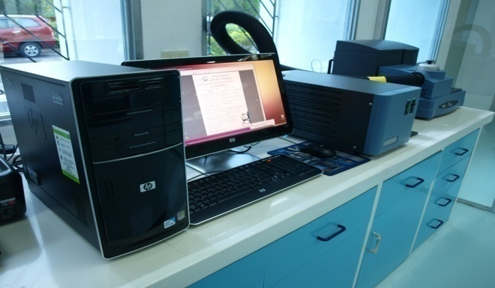
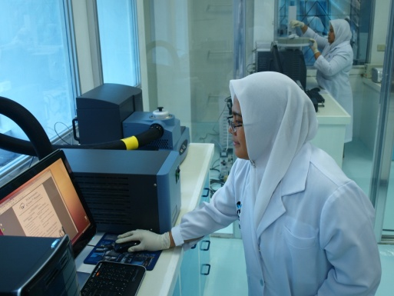
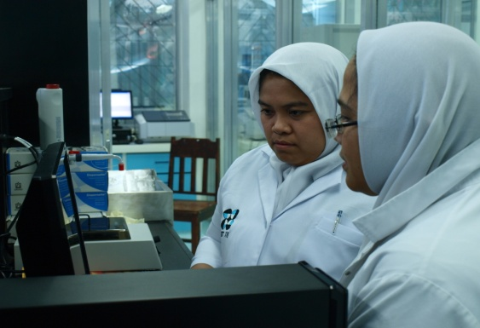
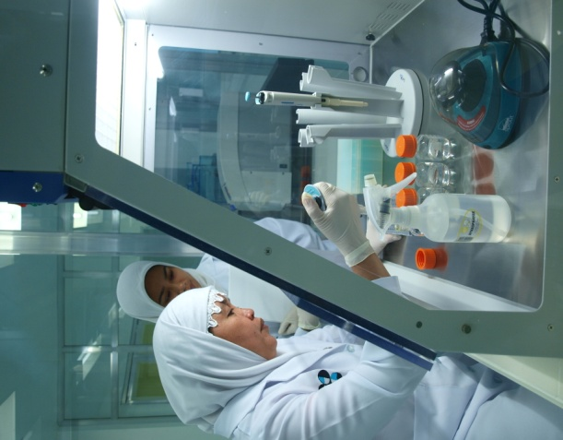
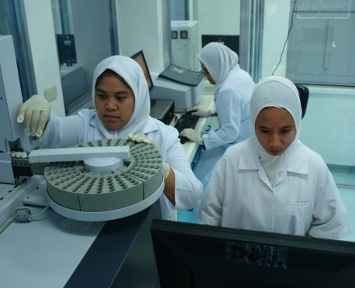
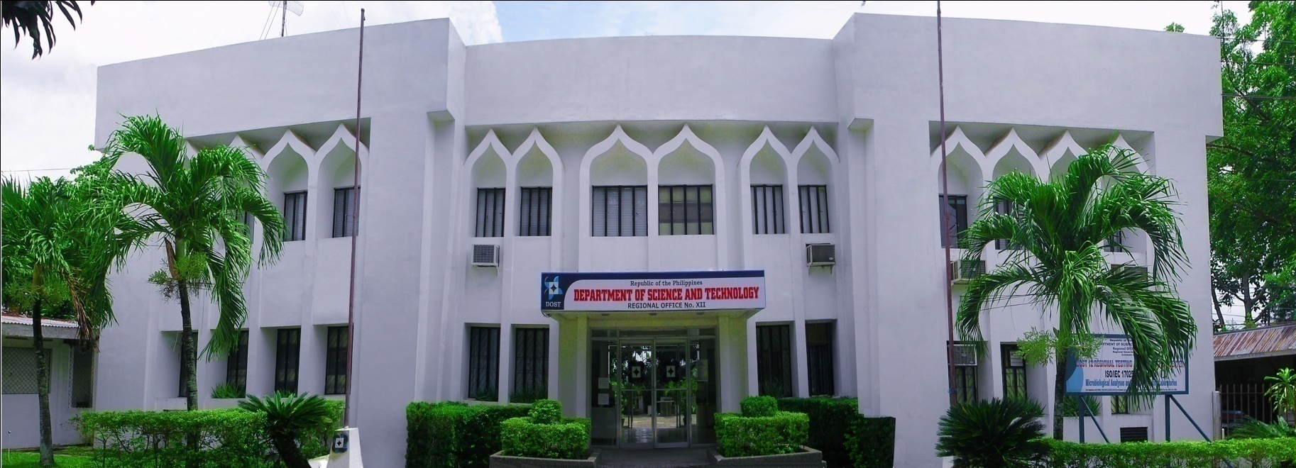
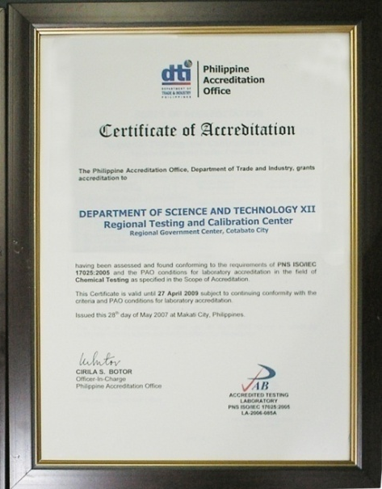
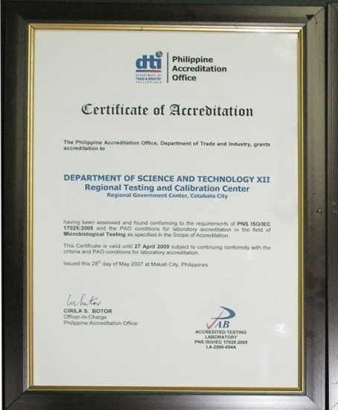
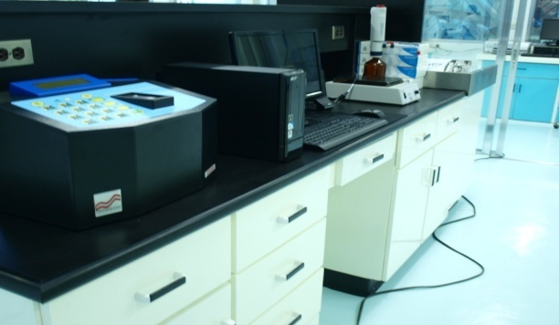
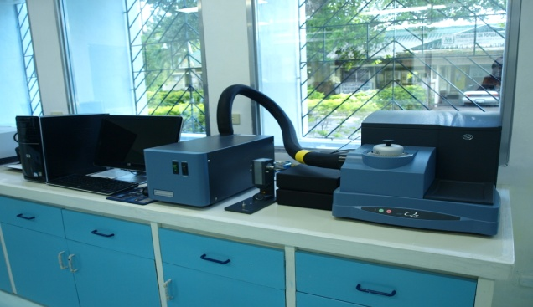
Halal Laboratory in Cotabato City has been established and is now in operation;
S&T Center
Cotabato City, Philippines

Slide 48
6th Component:
Halal Certification and Accreditation

Slide 49
Submit accomplished form to DOST XII
Sign Terms of Conditions set by DOST XII & NCMF
DOST XII & NCMF conduct audit/assessment/ surveillance on the ff:
Traceability/Plant Audit
Management System
Manufacturing
Procedures
DOST XII & NCMF Award Halal Certification
HALAL
Certification Process
DOST XII to issue Test Result/s
APPROVAL
From
Auditors/Assessors
DOST XII conducts Laboratory Tests & Analyses
DISAPPROVED
APPROVED
Verified
genuinely Halal
Verified
to contain Haram
*Firm/product did not pass the assessment; found non-conformant to H. Standards.
*Firm/Product passed the assessment and found to conform to H. Standards.
Consequence: can no longer continue w/ the process, however, should company/firm is still determined to avail of the Halal Certification, it should subject itself to re-assessment until proven to conform to H. Standards.
Consequence: continue/proceed with the next step.

Slide 50
Development Framework
Harnessing an ecosystem of knowledge-based , market-driven and technology-enabled SMEs thru synergy and strategic partnerships with the community, local government units, academe and government agencies and the private sector.

Slide 51
NATIONAL INNOVATION SYSTEM
Demand/
Needs
IMPROVEMENT OF QUALITY
OF LIFE OF SOCIETY
Public Welfare
Market Requirements
Policy directions
Support systems
GOVERNMENT
Products, Programs
and Services
ACADEME/
S&T COMMUNITY
Collaboration
INDUSTRY
IP generation and commercialization
Development/supply of S&T personnel
IP commercialization
Improvement of productivity
KNOWLEDGE BASE
ECONOMIC EDUCATION S&T LABOR TRADE and INDUSTRY
POLICIES POLICIES POLICIES POLICIES POLICIES
SOCIO-CULTURAL, POLITICAL AND ECONOMIC ENVIRONMENT

Slide 52
5-POINT FRAMEWORK FOR INNOVATION PROMOTION

Slide 53
Thank You
HALAL RESEARCH COUNCIL
Head Office: 192- Ahmad Block, New Garden Town , Lahore, Pakistan Ph: +92 42 35913096-8 , Fax: +92 42 35913056 E-mail : info@halalrc.org Web: www.halalrc.org

